Slide 1
JavaScript {
[Functions]
< David Tarvin, AIM Code School >
}
Programming Language

Slide 2
Review of what we’ve learned - functions
A function is a piece of program wrapped in a value – a reusable code block – that can be called by code outside the function itself
The function body contains the sequence of code statements to be executed when the function is called
We execute a function by putting parentheses after an expression that produces a function value

Slide 3
Functions – review (cont’d)
Any bindings in the parentheses following a function are called parameters (there might not be any)
Values are supplied for those bindings when calling the function – those values are called arguments
Arguments in a function do not all need to be the same data type

Slide 4
Functions as first-class objects
In JavaScript, a function is a first-class object
This means a function can be passed to other functions, returned from functions, and assigned to variables and properties
A function can also have properties and methods like any other object
The difference between functions and other objects is that functions can be called

Slide 5
Defining functions
JavaScript has several ways to define a function
Function declaration
Function expression
Arrow function
Method (covered when we discussed objects)
Function constructor (rarely used)

Slide 6
Function declaration
Function declaration - when a function is defined using the function keyword followed by a function name with a set of parentheses right afterward
function multiply(x, y) { return x * y; }

Slide 7
Function declaration (cont’d)
Function declarations are called using the name of the function followed immediately by a set of parentheses, either empty or containing arguments
multiply(6, 5);

Slide 8
Function expression
Function expression – when a function is defined within an expression
Example – when a function is assigned to a variable
let multiply = function(x, y) { return x * y; }
Call using the name of the variable to which the function was assigned
multiply(5,6);

Slide 9
Function expression (cont’d)
Two types of function expression
Anonymous function
Named function

Slide 10
Anonymous function
An anonymous function is a function expression where the name is omitted
Most commonly used type of function expression
let greeting = function(name) { console.log(`Hello ${name}.`); };
The name cannot be omitted in a function declaration, only in a function expression

Slide 11
Named function
A named function is a function expression where the name is not omitted
Used so the function can be called within itself
Mainly used for recursion (a later topic)
let greeting = function greet(name) { console.log(`Hello ${name}.`); };

Slide 12
Arrow function
An arrow function is a function expression that does not use the function keyword but instead uses an arrow => placed between the list of parameters and the opening curly brace
const multiply = (x, y) => { return x * y; }; // same as const multiply = function(x, y) { return x * y; }

Slide 13
Arrow function (cont’d)
An arrow function must be anonymous
If there is only one parameter, you can omit the parentheses around the parameter
const square1 = (x) { return x * x };
const square2 = x => { return x * x };

Slide 14
Arrow function (cont’d)
If the body is a single expression, the result of the expression is automatically returned from the function
You can omit the return keyword and the curly braces
const square3 = x => x * x;

Slide 15
Arrow function (cont’d)
If the arrow function has no parameters at all, the parameter list is just an empty set of parentheses
const horn = () => { console.log(“Toot”); };

Slide 16
Optional arguments
A function can be called with more arguments or fewer arguments than there are parameters defined in the function declaration.
If more, JavaScript will ignore the extra arguments and just use the arguments necessary for the parameters
If fewer, the parameters missing arguments are assigned the value undefined

Slide 17
Optional arguments
A function can be called with more arguments or fewer arguments than there are parameters defined in the function declaration.
If more, JavaScript will ignore the extra arguments and just use the arguments necessary for the parameters
If fewer, the parameters missing arguments are assigned the value undefined

Slide 18

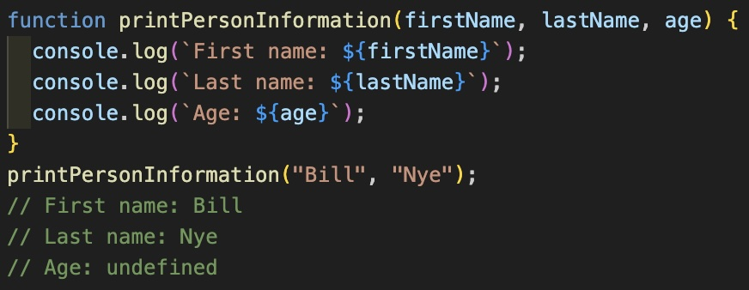
Fewer arguments (cont’d)

Slide 19
Optional arguments (cont’d)
Downside – we might accidentally pass the wrong number of arguments
Upside – we can use this behavior to allow a function to be called with different numbers of arguments

Slide 20
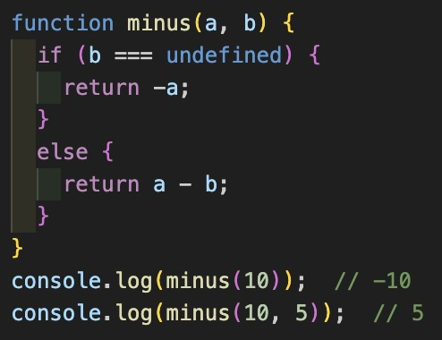
Optional arguments (cont’d)

Slide 21
Scope
Scope is the part of the program in which a binding is visible (can be accessed, can be changed)
Three types of scope in JavaScript
global scope
function scope
block scope
(also module scope, but that’s for later)

Slide 22
Global scope & global variable
Global scope - encompasses the whole program
Global variable - a variable that is defined outside of any function, block or
Is accessible anywhere in the program

Slide 23
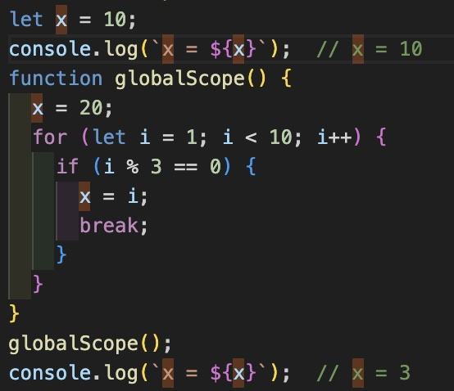
Global scope/variable (cont’d)

Slide 24
Local variable
Local variable – a variable created for a function parameter or declared inside a function
Related to two kinds of scope
Function scope
Block scope

Slide 25
Function scope
Encompasses everything in the function but nothing outside the function
Only a variable declared with var has function scope (not let or const)
Every time the function is called, new instances of its bindings/variables are created

Slide 26
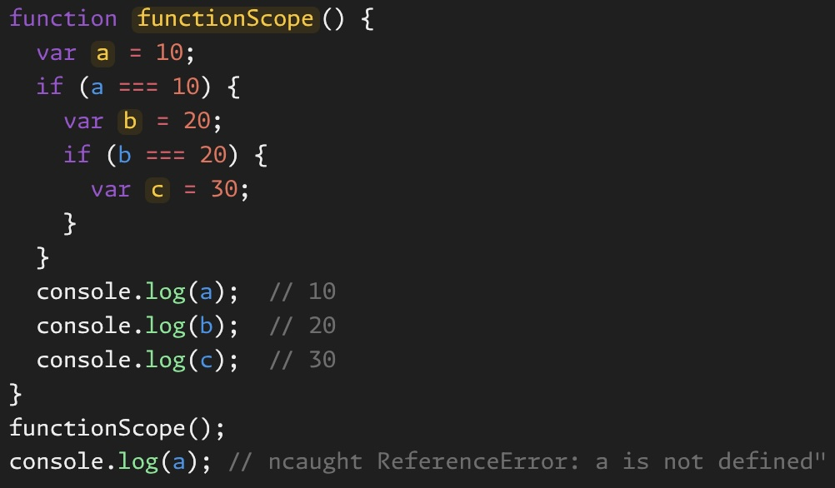
Function scope (cont’d)

Slide 27
Block scope
Encompasses only the code between the curly braces in which the variable is declare
Variables declared with let and const have block scope

Slide 28
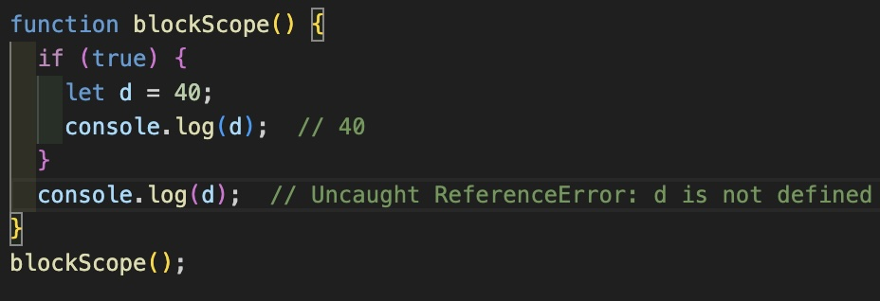
Block scope (cont’d)

Slide 29
Function hoisting
Function declarations create functions that are hoisted
multiply(6, 5);

Slide 30
BREAK

Slide 31
Bits
Bit - something that has two possible states/values
On or off
Zero or one
High charge or low charge
Strong or weak signal
Shiny or dull spot (CDs)
Binary - a base 2 numbering system
Count using only 0s and 1s

Slide 32
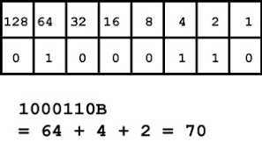
Binary
Binary - a base 2 numbering system
Count using only 0s and 1s

Slide 33
Bindings
Association of a name with a value
Also referred to as Named Binding
Purpose
To store values generated by expressions in your code
Allows you to reference those values in your code
Without bindings the program would not be able to remember the work it has already done

Slide 34
Binding - variables and constants
Variable - a type of binding that allows you to update the value associated with a particular name as needed
Constant - a type of binding where the value associated with a particular name cannot be changed
Notes:
Five different types of binding discussed here: https://medium.com/@sinalotfi.cs/javascript-named-binding-scope-and-closure-de48cc629f64

Slide 35
Declaring and assigning variables
Two steps:
let age; // declaring
age = 42; // assigning
One step:
let age = 42; // declaring and assigning

Slide 36
Variable naming
Cannot contain spaces
Can use underscores
Should use camelCase
If variable is one word, first letter is lowercase
let car = ”Audi”;
If variable is two or more words put together, first letter of first word is lower case and first letter of every other word is upper case
let numOfStudents = 23;

Slide 37
Variable naming (cont’d)
Name should be descriptive of what variable represents
Ex: for bank account balance:
let x = ”$10.00”; // WRONG
let accountBalance = “$10.00”; // RIGHT
Exception: temporary variables that serve a utility purpose such as incrementing a loop

Slide 38
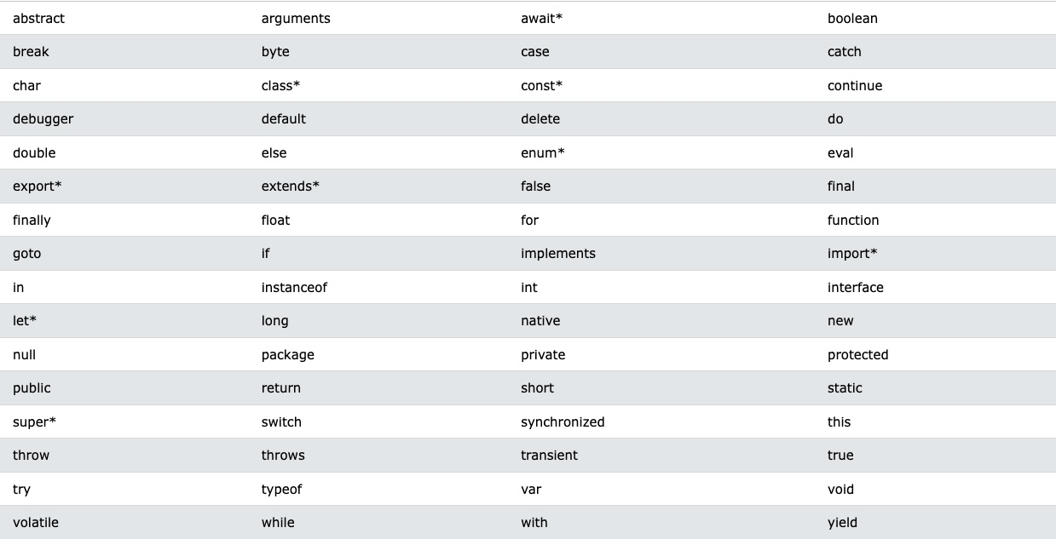
Reserved words (variable naming)

Slide 39
JavaScript {
[Data Types]
< David Tarvin, AIM Code School >
}
Programming Language

Slide 40
Two categories of data types
Primitive
Immutable
Copied by value
Non-Primitive
Mutable
Copied by reference

Slide 41
7 Primitive Data Types
string
boolean
Text/character values
true/false value
number
null
Numeric values
No value or empty value
BigInt
undefined
Values too large to be number data type
Not assigned a value
Symbol
For unique values

Slide 42
Data type string
Stores sequences of characters enclosed in single quotes (‘), double quotes (“) or backticks (`)
Problem with using single quotes - you can’t then use single quotes as an apostrophe without ‘escaping’ it
Will end string prematurely and cause error

Slide 43
Escape character (string)
Escaping a character is done using a backslash (\)
Used with special characters in a string so they are taken as the literal character rather than as a special character
Backslash also used with certain characters to do specific things with strings

Slide 44
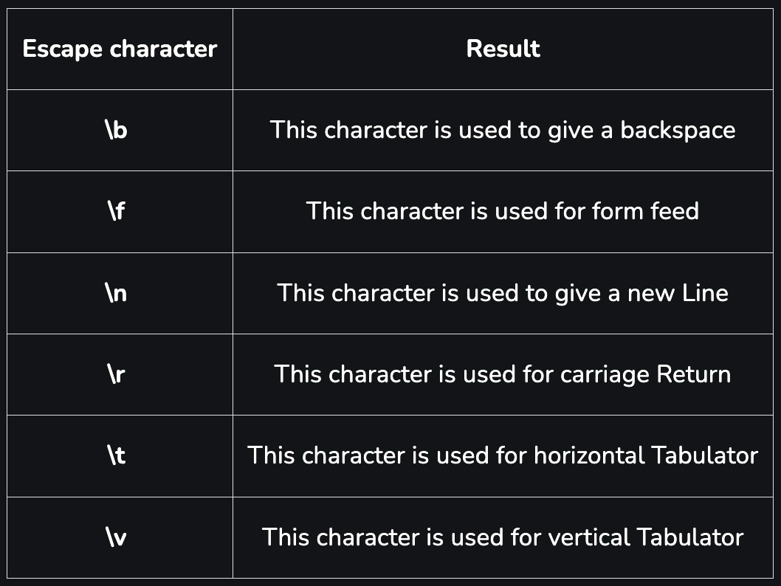
Escape character (string)

Slide 45
Newline character (string)
Break up code lines within strings with the newline character (\n)
let haiku = “Oh my aching back\n might as well claim workers comp\n it’s thrown out again”;

Slide 46
Concatenation (string)
Use plus sign (+) to put two or more strings together, along with variable or numbers to go with the strings
Hint - don’t forget spaces
// Concatenation let numOfStudents = 23; console.log(“There are “ + numOfStudents + “ students in my class.”); // There are 23 students in my class.

Slide 47
Template literals (string)
Done using backticks (`)
Allow you to put whole string together, including variables, instead of breaking string up and concatenating
Variables are included by putting variable in curly braces {} and prefixing the braces with a dollar sign ($)
// Template literal console.log(`There are ${numOfStudents} students in my class.`); // There are 23 students in my class.

Slide 48
Data type number
Handles any numerical value
Doesn’t differentiate between integers and floats (other languages do)
Integers - numbers without decimals (15, -12, 0)
Floats - numbers with decimals (42.05, -26.00007)

Slide 49
Data type number (cont’d)
Numbers are fixed as 64-bit values
Referred to as 64-bit floating point
Means they can represent 2^64 different numbers (18 quintillion - 18 zeros)
One bit has to represent sign (negative or positive)
Eleven bits have to store exponent
52 bits store the number (the fraction)

Slide 50
Underscores (number)
Long numbers are hard to read
8665481257
Underscores can make them easier to read without affecting the operation of the code
8_665_481_257

Slide 51
Scientific notation (number)
For extremely large or small numbers, use scientific notation
add an e for exponent followed by the exponent of the number
Ex: 2.998e8 = 2.998 * 10^8 = 299,800,000

Slide 52
Integer precision (number)
Highest integer that can be used in precise calculations is 2^53 - 1 (9,007,199,254,740,991 - approx 9 quadrillion)
Try this: let a = 9_007_199_254_740_991; let b = 100_000; console.log(a + b);
But: console.log(740_991 + 100_000);

Slide 53
Floating precision (number)
Floating point arithmetic is not always 100% accurate
console.log(0.2 + 0.1); // 0.30000000000000004
To solve the problem:
multiply the floating numbers by a common power of ten (10, 100, 1000) so they become integers
conduct the arithmetic
divide the result by the same power of 10 you multiplied with

Slide 54
Floating precision cont’d
let x = 0.2; let y = 0.1;
Step 1:
Multiply 0.2 * 10 and 0.3 * 10 // 2 + 1
Conduct arithmetic // 2 + 1 = 3
Divide result by 10 // 3/10 = 0.3
(0.2 + 0.1) is the same as (0.2*10 + 0.1*10)/10

Slide 55
Infinity, -Infinity (number)
Highest number in JavaScript:
1.797693134862315e+308
Any number higher than that is referred to as Infinity
Lowest number in JavaScript:
1.797693134862316e+308
Any number lower than that is referred to as -Infinity

Slide 56
NaN (number)
NaN – stands for “Not a Number”
However, typeof NaN == ‘number’
It is a numeric type whose specific value cannot be represented within the limitations of the numeric type (WHAT????)
NaN does not equal another NaN and does not even equal itself
var x = NaN; console.log(x == x); // false

Slide 57
Adding numbers and strings (number)
Adding two numbers results in a number
console.log(10 + 20); // 30
Adding two strings results in concatenation
A number surrounded by quotes is a numeric string
console.log(“10” + “20”); // 1020

Slide 58
Adding numbers and strings (number)
Adding a number and a numeric string results in concatenation
console.log(10 + “20”); // 1020
console.log(“10” + 20); // 1020

Slide 59
Adding numbers and strings (number)
let x = 45; let y = 25;
Let z = “15”;
What is the result here?
console.log(“The result is: “ + x + y);
What is the result here?
console.log(“The result is: “ + (x + y));

Slide 60
Adding numbers and strings (number)
let x = 45; let y = 25;
Let z = “15”;
What is the result here?
console.log(x + y + z);
What is the result here?
console.log(x + (y + z);

Slide 61
Data type BigInt
BigInt - a numerical data type representing both small and large numbers that cannot be represented by the data type number
Must contain a lowercase n after the number, e.g. 426n

Slide 62
Data type BigInt (cont’d)
Two ways to create:
Append n to a whole number
const bigIntOne = 135n;
Call BigInt() on a whole numerical value or a string with only an integer value
const bigIntTwo = BigInt(964);
Bad practice - could already have precision loss
const bigIntThree = BigInt(“857”);

Slide 63
Type Coercion (BigInt)
Type coercion involves the conversion of values from one data type to another
Typically performed during operations or comparisons of different data types
Done when necessary to complete the operation or comparison
Remember the concatenation of the strings and the number? The number was coerced to a string

Slide 64
BigInt vs number (BigInt)
Differences from numbers
Cannot be used with methods from the Math object
Cannot be mixed with a number value in operations (addition, subtraction, etc.)
Would need to be coerced to the same type (change BigInt to number or vice versa)
Coercion back and forth can cause a loss of precision

Slide 65
Data type boolean
Two values: true or false
Can convert a non-boolean value (like a string) to a boolean one of two ways
Precede the value with two exclamation marks (!!numOfStudents)
Use the Boolean function – Boolean()
Boolean(numOfStudents)
Never use the word new with Boolean()

Slide 66
Truthy/falsy values (boolean)
Values that get coerced to false are called falsy values
All other coerced values are truthy values

Slide 67
Truthy/falsy values (boolean)
Values that get coerced to false are called falsy values
All other coerced values are truthy values

Slide 68
Truthy/falsy values (cont’d)
undefined and null turn into false
0, -0, and NaN turn into false
All other numbers turn into true
0n turns into false
all other BigInts turn into true
The empty string “” turns into false
All other strings turn into true
Symbols and Objects become true

Slide 69
Symbol
Used to specify that two variables are not equal, even though their value and type are the same
let str1 = “JavaScript is fun!”; let str2 = “JavaScript is fun!”; console.log(str1 == str2); // true
let sym1 = Symbol(“JavaScript is fun!”); let sym2 = Symbol(“JavaScript is fun!”); console.log(sym1 == sym2); // false

Slide 70
undefined
undefined – means the variable has not been assigned a value
var a; console.log(a); // undefined typeof (a); // ‘undefined’

Slide 71
undefined (cont’d)
WATCH OUT – you actually CAN assign a value of ‘undefined’ to a variable
BAD PRACTICE – would cause a variable that has not been assigned a value and a variable that has been manually given a value of undefined to be considered equal

Slide 72
null
null – means the variable has no value or an empty value
BUT – it is a type of assignment value because you can assign a value of null to a variable
null == undefined but null !== undefined (more on this later)
typeof null; // ‘object’

Slide 73
Non-primitive data types
Object
Includes Arrays, Functions and Regular Expressions

Slide 74
Array
An array is a list of values
const fruits = [“Banana”, “Apple”, “Orange”, “Kiwi”];
Without arrays we would need a separate variable for each value
const fruit1 = “Banana”; const fruit2 = “Apple”; const fruit3 = “Orange”; const fruit4 = “Kiwi”;
Problematic when it comes to adding new values or comparing each value with another

Slide 75
Array Literal Notation
Two square brackets [] define the beginning and end of the array
The individual values included in the array are written between the square brackets and are separated by commas

Slide 76
Declaring an array
An array can be declared, using literal notation, as empty from the outset or containing values
const clothes = []; const shoes = [‘Ugg’, ‘Birks’, ‘Reebok’];
You can also declare an array using the constructor Array()
let toys = new Array(‘car’, ‘boat’, ‘soldier’, ‘yoyo’);

Slide 77
Declaring an array (cont’d)
When using the array constructor, the word new is not actually required
let colors = Array(‘purple’, ‘yellow’, ‘green’, ‘orange’, ‘blue’);
Passing in a single number with the array constructor fills the array with that number of empty values
let myArray = new Array(4); // [,,,]

Slide 78
Array (cont’d)
An array can be written on a single line or on multiple lines
const shoppingCart = [ ‘Record Player’, ‘Loudspeaker’, ‘Preamplifier’, ‘Loudspeaker Cables’ ];
const highscores = [74334, 24344, 54333];

Slide 79
Array - data types
Arrays in JavaScript can contain values with different data types
const values = [‘John Doe’, 22, true];

Slide 80
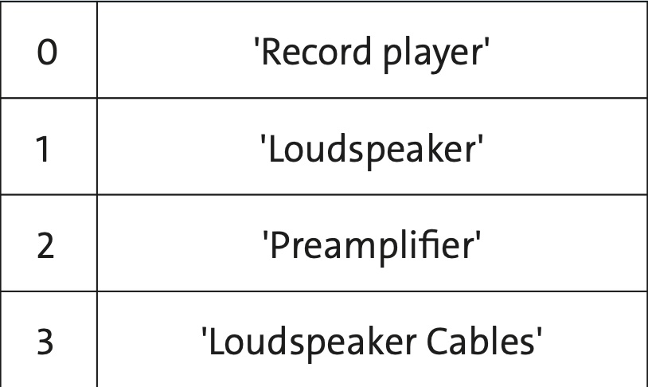
Structure of arrays
Arrays have an index-based structure that starts at 0 and increases by 1 for each entry
The last element of an array is at index n-1, where n is the length of the array

Slide 81
Using array index numbers
You can reference a value in an array by using the name of the array followed by square brackets containing the index number of the value you want
const cars = [‘Audi’, ‘BMW’, ’Chrysler’, ‘Dodge’];
console.log(cars[1]); // BMW

Slide 82
Array.length
Arrays know their own length
const doll = [‘Susie’, ‘Addy’, ‘Jennifer’];
console.log(doll.length); // 3

Slide 83
Looping through an array
const veggies = [‘Asparagus’, ‘Broccoli’, ‘Cabbage’, ‘Pea’, ‘Zucchini’];
for (let i = 0; i < veggies.length; i++) { console.log(`Veggie number ${i+1} is a ${veggie[i]}.`); }
// Veggie number 1 is a Asparagus // Veggie number 2 is a Broccoli // Veggie number 3 is a Cabbage // (etc)

Slide 84
Looping through an array
const veggies = [‘Asparagus’, ‘Broccoli’, ‘Cabbage’, ‘Pea’, ‘Zucchini’];
for (let i = 0; i < veggies.length; i++) { console.log(`Veggie number ${i+1} is a ${veggie[i]}.`); }
// Veggie number 1 is a Asparagus // Veggie number 2 is a Broccoli // Veggie number 3 is a Cabbage // (etc)

Slide 85
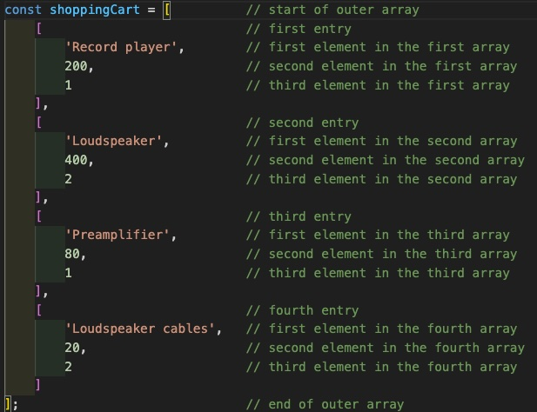
Multidimensional arrays

Slide 86
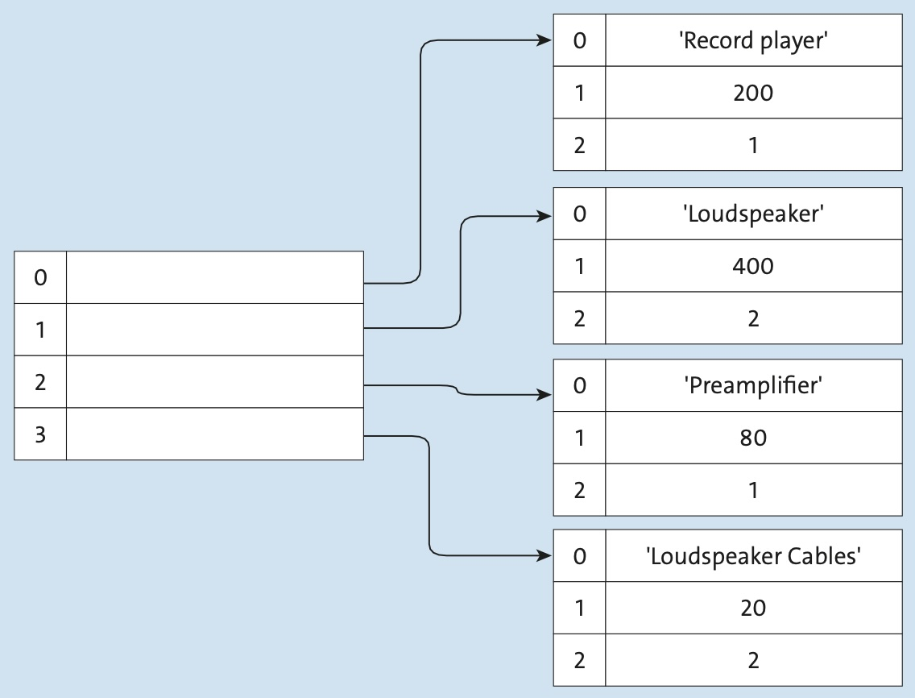
Multidimensional arrays (cont’d)

Slide 87
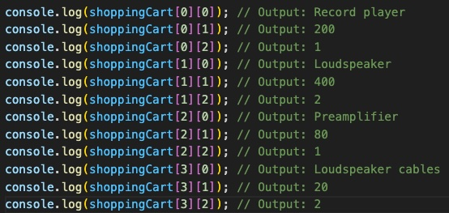
Multidimensional arrays (cont’d)

Slide 88
Object

Slide 89
Immutability
Means value cannot be changed once assigned
Can assign new value but cannot change old value
Ex: if assigning a string value to a variable, we could assign a new value to the variable, but we could not change a character in the old value
var word = “cat”; console.log(word[0]); // c word[0] = “r”; // no error shows console.log(word[0]); // c console.log(word); // cat

Slide 90
Copying by value vs by reference
All variable values are stored in memory at specific addresses
Copying of a variable is done with the “=” assignment operator

Slide 91
Copying by value vs by reference
Copying by value (primitive data type):
Variable holds the value directly
Variable doesn’t know the memory address of the value
Even if two variables have the same value for the same primitive data type, those values are stored at different memory locations
Copying by Reference (non-primitive data type):
Variable holds the memory address of the value, not the value directly

Slide 92
Copying by value
Means the new variable holds a copy of the old variable
The variables hold the same value but at different memory locations
Changing one does not affect the other
var a = 1; var b = a; a = 3; console.log(a); // 3 console.log(b); // 1

Slide 93
Copy by reference
Means the new variable holds a copy of the old variable’s reference to the value
Both variables hold not the value itself but the memory address for the value
Changing the value for one changes the value for the other
var a = [8, 3];
var b = a;
a.push(5);
console.log(a); // [8, 3, 5]
console.log(b); // [8, 3, 5]

Slide 94
Contents Of ‘This Template’;
forbeginners.html
workshop.css
Here’s what you’ll find in this Slidesgo template:
A slide structure based on a Workshop presentation, which you can easily adapt to your needs. For more info on how to edit the template, please visit Slidesgo School or read our FAQs.
An assortment of graphic resources that are suitable for use in the presentation can be found in the alternative resources slide.
A thanks slide, which you must keep so that proper credits for our design are given.
A resources slide, where you’ll find links to all the elements used in the template.
Instructions for use.
Final slides with:
The fonts and colors used in the template.
A selection of illustrations. You can also customize and animate them as you wish with the online editor. Visit Storyset to find more.
More infographic resources, whose size and color can be edited.
Sets of customizable icons of the following themes: general, business, avatar, creative process, education, help & support, medical, nature, performing arts, SEO & marketing, and teamwork.
You can delete this slide when you’re done editing the presentation.
Programming Language

Slide 95
Table Of ‘Contents’ {
01
02
03
forbeginners.html
workshop.css
Theory Lesson
< You can enter a subtitle here if you need it >
Features of the Topic
< You can enter a subtitle here if you need it >
Practical Exercise
< You can enter a subtitle here if you need it >
}
Programming Language

Slide 96
01 {
[Theory Lesson]
forbeginners.html
workshop.css
< You can enter a subtitle here if you need it >
}
Programming Language

Slide 97
Concepts < /1 > {
forbeginners.html
workshop.css
< Mercury is the closest planet to the Sun and the smallest one in the Solar System—it’s only a bit larger than the Moon >
}
Concepts < /2 > {
< Venus has a beautiful name and is the second planet from the Sun. It’s hot and has a poisonous atmosphere >
}
Programming Language

Slide 98
Introduction; {
forbeginners.html
workshop.css
‘Here you can give a brief description of the topic you want to talk about’
<p For example, if you want to talk about Mercury, you can say that it’s the smallest planet in the entire Solar System >
</p>
}
Programming Language

Slide 99
What Is this ‘Topic About ?’ {
forbeginners.html
workshop.css
Languages
Html
60%
Css
40%
< Mercury is the smallest planet in the entire Solar System >
< The Earth is the only one that harbors life in the Solar System >
Create a web page
Venus has a nice name
Mars is a cold place
Jupiter is a gas giant
}
Programming Language

Slide 100
Features of ‘the Topic’ {
forbeginners.html
workshop.css
Step 01
Mercury is the closest planet to the Sun and the smallest one
Step 02
Saturn is a gas giant and has several rings
Step 03
The Earth is the only planet that harbors life
Step 04
Venus has a beautiful name and is the second planet from the Sun
}
Programming Language

Slide 101
Recommendations; {
forbeginners.html
workshop.css
Mercury
< Mercury is the closest planet to the Sun and the smallest one in the Solar System >
Saturn
< It was named after the Roman god of wealth and agriculture >
Jupiter
< Jupiter is a gas giant and the biggest planet in the Solar System >
}
Programming Language

Slide 102
Examples About ‘The Topic’{
forbeginners.html
workshop.css
Mercury
Jupiter
< Mercury is the closest planet to the Sun >
< Jupiter is a gas giant and the biggest planet >
Saturn
Venus
< Saturn is a gas giant and has several rings >
< Venus has a nice name and high temperatures >
}
Programming Language

Slide 103
Practical Exercise {
< /1 >
< /2 >
forbeginners.html
workshop.css
< Saturn is the fourth-largest object by diameter in the Solar System >
Mercury is the smallest planet
The Earth is the planet we live on
Saturn is made of oxygen and helium
Jupiter is a gas giant
Venus has high temperatures
Neptune is very far away from the Sun
}
Programming Language

Slide 104
9h 55m 23s {
333,000.000
386,000 km
forbeginners.html
workshop.css
< Is Jupiter's rotation period >
< Earths fit in the Sun’s mass >
< Distance between the Moon and the Earth >
}
Programming Language

Slide 105

A ‘Picture’ Is { Worth a Thousand Words
}

Slide 106
Awesome { Words;
forbeginners.html
workshop.css
}
Programming Language

Slide 107
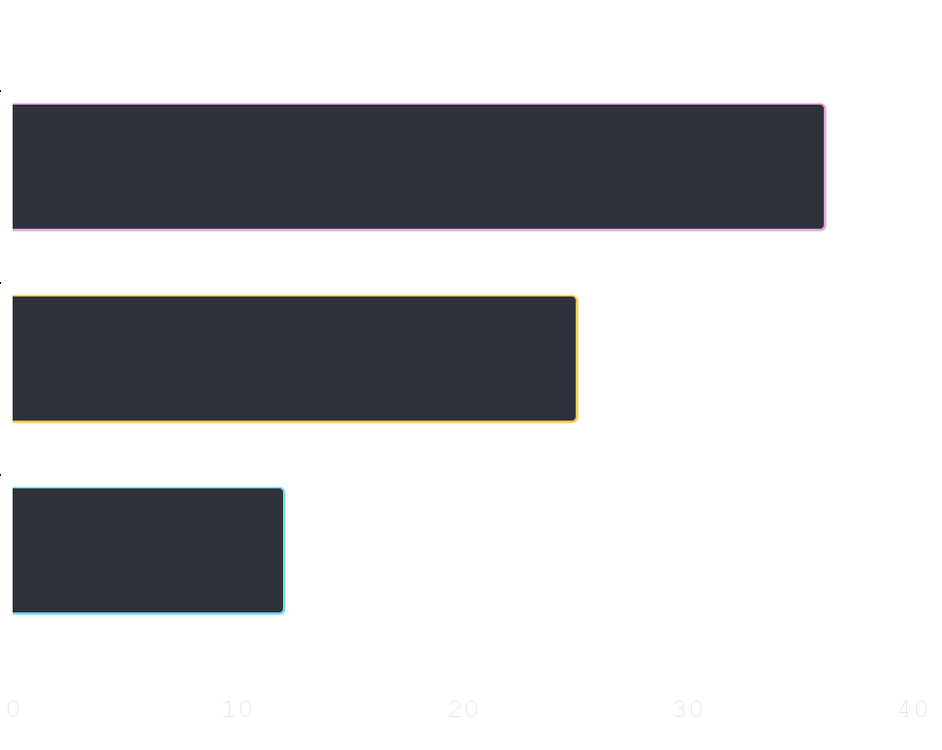
Did You Know ‘This ?’ {
forbeginners.html
workshop.css
36.00
Mercury is the smallest planet of the Solar System
25.00
Venus has a beautiful name and high temperatures
12.00
Despite being red, Mars is actually a cold place
}
Follow the link in the graph to modify its data and then paste the new one here. For more info, click here
Programming Language

Slide 108

A ‘Picture’ Always Reinforces The Concept {
forbeginners.html
workshop.css
< Images reveal large amounts of data, so remember: use an image instead of a long text. Your audience will appreciate it >
}
Programming Language

Slide 109
150,005,630 {
forbeginners.html
workshop.css
< Big numbers catch your audience’s attention >
}
Programming Language

Slide 110
— Someone ‘Famous’
forbeginners.html
workshop.css
< “This is a quote, words full of wisdom that someone important said and can make the reader get inspired.” >
Programming Language

Slide 111
Review ‘Concepts’ {
forbeginners.html
workshop.css
< Mercury is the closest planet to the Sun and the smallest one in the Solar System >
Venus
Ceres
Saturn
}
Programming Language

Slide 112
Planning of ‘September’{
forbeginners.html
workshop.css
M | T | W | T | F | S | S
 |  | 01 | 02 | 03 | 04 | 05
06 | 07 | 08 | 09 | 10 | 11 | 12
13 | 14 | 15 | 16 | 17 | 18 | 19
20 | 21 | 22 | 23 | 24 | 25 | 26
27 | 28 | 29 | 30
Mercury is the smallest planet
Venus has a beautiful name
The Earth is the third planet
Mars is actually a cold place
Jupiter is a gas giant
}
Programming Language

Slide 113
JavaScript For ‘Beginners’ {
forbeginners.html
workshop.css
Mercury
Mars
It is the closest planet to the Sun
Despite being red, Mars is a cold place
Jupiter
Venus
Jupiter is the biggest planet
Venus is the second planet from the Sun
Saturn
Neptune
Saturn is a gas giant and has several rings
Neptune is very far from the Earth
}
Programming Language

Slide 114
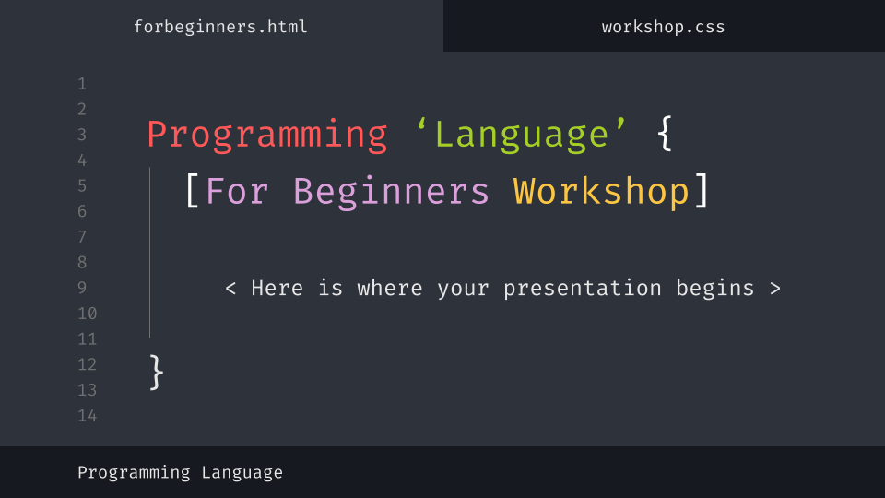
Desktop Software {
forbeginners.html
workshop.css
You can replace the image on the screen with your own work. Just delete this one, add yours and center it properly
}
Programming Language

Slide 115
Thanks; {
forbeginners.html
workshop.css
‘Do you have any questions?’
youremail@freepik.com
+91 620 421 838
yourcompany.com
< Please keep this slide for attribution >
}
Programming Language

Slide 116
Web ‘Design’
forbeginners.html
workshop.css
Programming Language

Slide 117
Alternative ‘Resources’ {
forbeginners.html
workshop.css
Here’s an assortment of alternative resources whose style fits the one of this template
Photos:
Portrait hacker I
Portrait hacker II
}
Programming Language

Slide 118
Resources {
forbeginners.html
workshop.css
Did you like the resources on this template? Get them for free at our other websites:
Photos:
Close up hacker
Medium shot woman working computer
Icons:
Web design
}
Programming Language

Slide 119
Instructions for use
In order to use this template, you must credit Slidesgo by keeping the Thanks slide.
You are allowed to:
- Modify this template.
- Use it for both personal and commercial projects.
You are not allowed to:
- Sublicense, sell or rent any of Slidesgo Content (or a modified version of Slidesgo Content).
- Distribute Slidesgo Content unless it has been expressly authorized by Slidesgo.
- Include Slidesgo Content in an online or offline database or file.
- Offer Slidesgo templates (or modified versions of Slidesgo templates) for download.
- Acquire the copyright of Slidesgo Content.
For more information about editing slides, please read our FAQs or visit Slidesgo School:
https://slidesgo.com/faqs and https://slidesgo.com/slidesgo-school

Slide 120
Instructions for use (premium users)
As a Premium user, you can use this template without attributing Slidesgo or keeping the "Thanks" slide.
You are allowed to:
Modify this template.
Use it for both personal and commercial purposes.
Hide or delete the “Thanks” slide and the mention to Slidesgo in the credits.
Share this template in an editable format with people who are not part of your team.
You are not allowed to:
Sublicense, sell or rent this Slidesgo Template (or a modified version of this Slidesgo Template).
Distribute this Slidesgo Template (or a modified version of this Slidesgo Template) or include it in a database or in any other product or service that offers downloadable images, icons or presentations that may be subject to distribution or resale.
Use any of the elements that are part of this Slidesgo Template in an isolated and separated way from this Template.
Register any of the elements that are part of this template as a trademark or logo, or register it as a work in an intellectual property registry or similar.
For more information about editing slides, please read our FAQs or visit Slidesgo School:
https://slidesgo.com/faqs and https://slidesgo.com/slidesgo-school

Slide 121
Fonts & colors used
This presentation has been made using the following fonts:
Fira Code
(https://fonts.google.com/specimen/Fira+Code)
#16191f
#2e323b
#707070
#e7e7e7
#ffffff
#ff5858
#fcc642
#dba0db
#72d9f0
#a5cf27

Slide 122
Storyset
Create your Story with our illustrated concepts. Choose the style you like the most, edit its colors, pick the background and layers you want to show and bring them to life with the animator panel! It will boost your presentation. Check out How it Works.
Pana
Amico
Bro
Rafiki
Cuate

Slide 123
Use our editable graphic resources...
You can easily resize these resources without losing quality. To change the color, just ungroup the resource and click on the object you want to change. Then, click on the paint bucket and select the color you want. Group the resource again when you’re done. You can also look for more infographics on Slidesgo.

Slide 126
JANUARY
FEBRUARY
MARCH
APRIL
MAY
JUNE
PHASE 1
Task 1
Task 2
PHASE 2
Task 1
Task 2
JANUARY
FEBRUARY
MARCH
APRIL
PHASE 1
Task 1
Task 2

Slide 129
...and our sets of editable icons
You can resize these icons without losing quality.
You can change the stroke and fill color; just select the icon and click on the paint bucket/pen.
In Google Slides, you can also use Flaticon’s extension, allowing you to customize and add even more icons.

Slide 130
Educational Icons
Medical Icons

Slide 131
Business Icons
Teamwork Icons

Slide 132
Help & Support Icons
Avatar Icons

Slide 133
Creative Process Icons
Performing Arts Icons

Slide 134
Nature Icons

Slide 135
SEO & Marketing Icons

Slide 136


